Slide 1


Advanced Data Mining
Associations and Correlations
From Market Basket Analysis to Multidimensional Rules
Submitted by,
Devansh Singh
[RA2311003030543]
CSE {Core}- I

Slide 2


Market Basket Analysis (MBA)
Discovering Purchase Patterns
MBA is a data mining technique used to identify relationships between items frequently purchased together. It powers recommendation systems (e.g., "Customers who bought this also bought...").
Goal: Find correlations in transactional datasets.
Application: Supermarket placement, cross-selling, and inventory management.
Example: If customers buy Bread, do they also buy Butter?

Slide 3










Key Metrics: Support, Confidence, Lift
Support
Confidence
Lift
Frequency of itemset appearance.
Likelihood B is bought if A is bought.
Strength of association vs. chance.

Slide 4
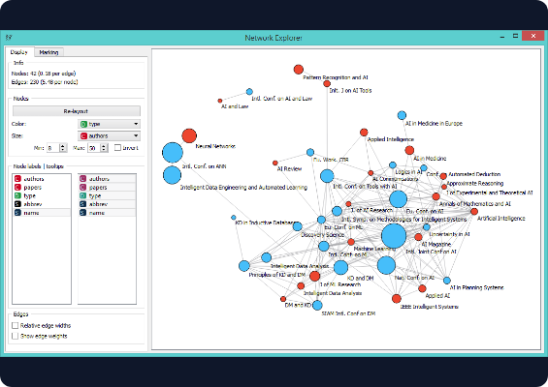
The Apriori Algorithm
The "Bottom-Up" Approach
Apriori iteratively identifies frequent itemsets by expanding from 1-itemsets to k-itemsets.
Apriori Property: If an itemset is frequent, all its subsets must also be frequent.
Pruning: Effectively removes infrequent candidates to save computation.
Iterative: Generate candidates → Prune based on Min Support → Repeat.

Slide 5

Apriori in Action: Data Walkthrough
Scenario: Min Support = 40%, Min Confidence = 60%. Total Transactions = 5.
Calculation & Result
ID | Items
1 | Milk, Bread, Butter
2 | Milk, Bread
3 | Bread, Butter
4 | Milk, Butter
5 | Bread, Jam
1. Support Check: Milk (60%), Bread (80%), Butter (60%). Jam (20%) is pruned.
2. Frequent Pairs: {Milk, Bread}, {Milk, Butter}, {Bread, Butter} (All 40%).
3. Rule Generation:
Conf = 40% / 60% = 66.7% (Valid Rule)

Slide 6
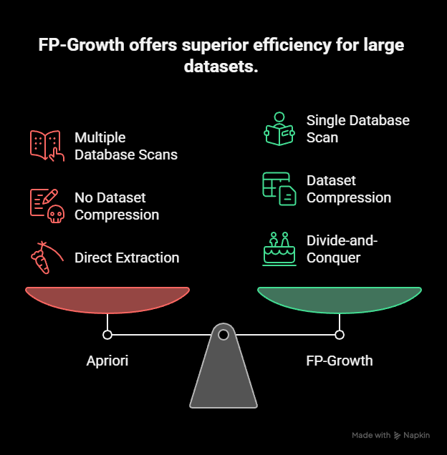
FP-Growth: No Candidate Generation
Efficiency Over Apriori
Apriori requires multiple database scans. FP-Growth is faster.
Concept: Compresses the dataset into a Frequent Pattern Tree (FP-Tree).
Process: Scans DB once to count items, then builds tree.
Mechanism: Uses a divide-and-conquer strategy to extract frequent itemsets directly from the tree structure.
Result: Significantly faster for large, dense datasets.

Slide 7
Mining with Vertical Data Format (ECLAT)
Horizontal formats store transactions. Vertical formats store Transaction ID (TID) sets for each item.
Vertical (TID Sets)
Horizontal (Standard)
Item | TID Set
A | {1, 3}
B | {1, 2, 3}
C | {2, 3}
E | {1, 2, 3}
TID | Items
1 | A, B, E
2 | B, C, E
3 | A, B, C, E
*Intersection of TID sets allows fast support calculation without scanning the whole DB.*

Slide 8





Closed Frequent Itemsets
Definition
Advantage
Example
An itemset X is "closed" if no superset of X has the same support count as X.
Reduces redundancy. Instead of storing all frequent patterns, we store a compact set without losing information.
If {A, B} support is 3, and superset {A, B, C} support is 2, then {A, B} is likely closed.
(Assuming no other superset has support 3)

Slide 9

Multilevel Association Rules
Mining at Different Abstractions
Items often belong to hierarchies. We can mine rules at multiple levels.
Hierarchy Example
Level 1 (Category): {Beverages} → {Snacks}
Beverages (Support 100%)
Level 2 (Subcategory): {Soft Drinks} → {Chips}
Soft Drinks (60%)
Coca-Cola (40%)
Level 3 (Item): {Coca-Cola} → {Lays}
Pepsi (20%)
Strategy: Use lower support thresholds for lower levels (specific items are less frequent than categories).

Slide 10

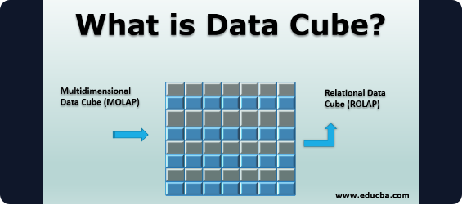
Multidimensional Association Rules
Extends mining beyond just "items" to include attributes like Age, Gender, and Location.
Types of Rules
Inter-Dimension: Relationships between different dimensions.
(Education=Grad) → (Income=High)
Hybrid-Dimension: Mixes attributes and items.
(Age=25-40, USA) → {Laptop}
Intra-Dimension: Patterns within the same dimension.
(Category=Electronics) → (Buys=Phone)
Rule Example: (Age=20-30, Location=Urban) → (Buys=Sports Shoes)

Slide 11
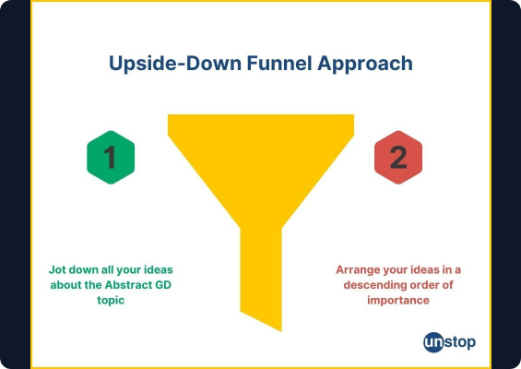
Constraint-Based Mining
Filtering for Relevance
Instead of mining all rules, users define constraints to focus on useful patterns.
Knowledge-Based: "Only find rules involving Electronics."
Data Constraints: "Transactions > $100."
Aggregate Constraints: "Total Price > $200."

Slide 12
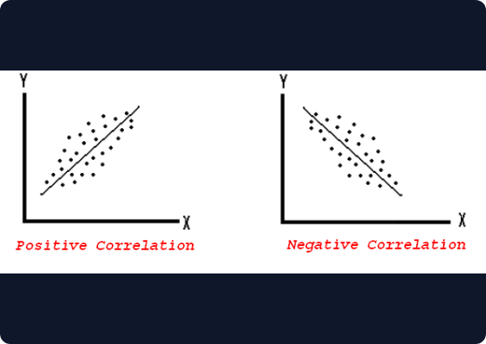
Correlation Analysis
Beyond Association
Association rules find frequency (A & B happen together). Correlation measures the direction and strength of the relationship.
Positive: A increases → B increases.
Negative: A increases → B decreases.
Independent: No relationship (Lift = 1).

Slide 13


Measures of Correlation
Pearson Coefficient (r)
Chi-Square Test
For linear relationships between continuous variables (-1 to +1).
For categorical data independence.
O = Observed, E = Expected

Slide 14
THANK YOU

